Slide 1


AlphaFold 2
A paradigm shift in structural biology
Francisco J. Palmero Moya
Nynke Dekker Lab
13/10/2023
Notes:
A deep learning approach for protein structure prediction called AlphaFold2.
It was developed by Google DeepMind.
It implies a paradigm shift in structural biology.

Slide 2
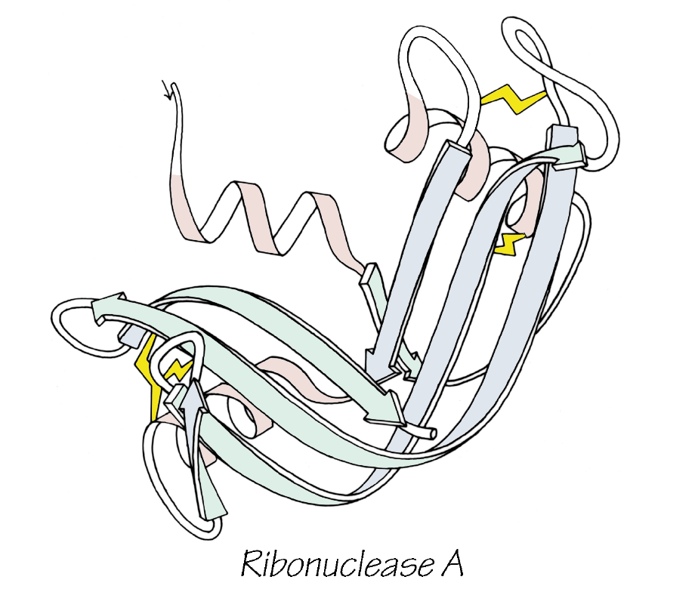
Context: Protein folding process
Proteins are the workhorses of the cell, carrying out essential functions which are mainly determined by its structure.
They are initially synthesized as linear chains of amino acids that spontaneously fold into complex 3D structures.
The resulting 3D structure is determined by the amino-acid sequence (Anfinsen's dogma).
Understanding and simulating the protein folding process has been an important challenge for computational biology.
Notes:
First of all, a little bit of context. I think I don't need to convince you about why proteins are essential to life.

Slide 3
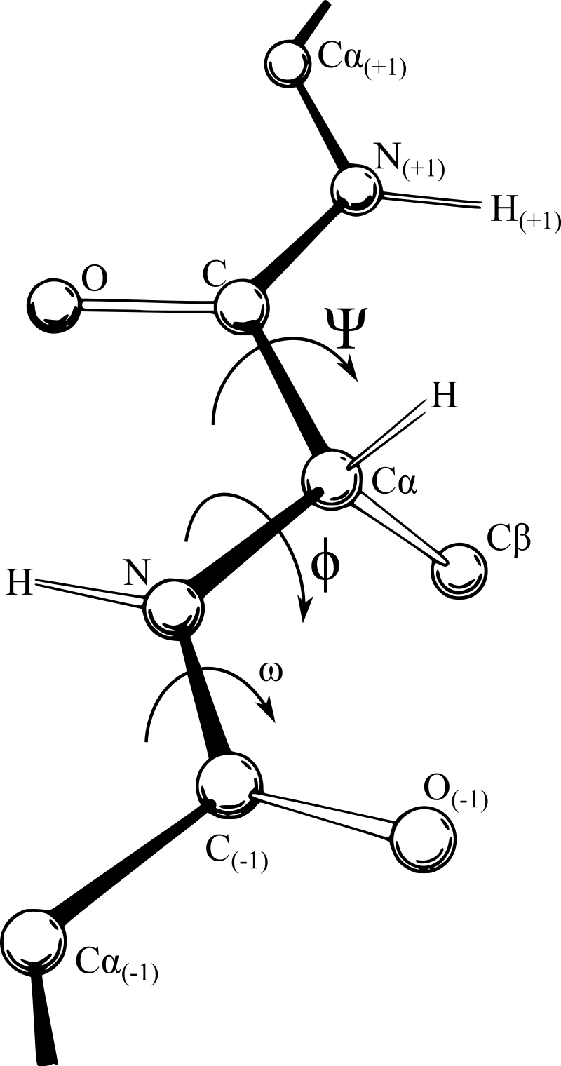
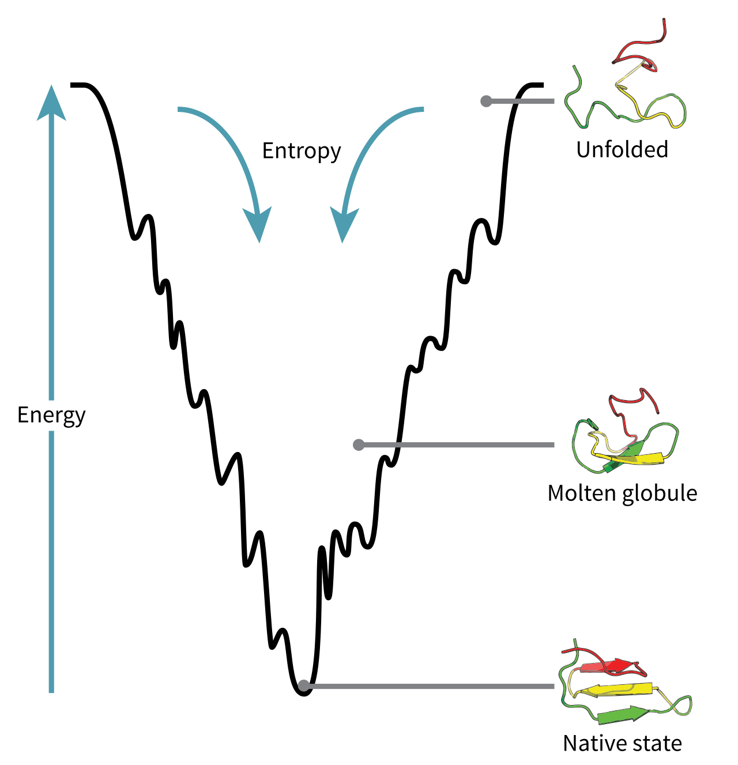
Context: Protein folding problem
Proteins have an enormous number of possible conformations due to the very large degrees of freedom.
A random sequential sampling of all these conformations would take an impractically long time (Levinthal's Paradox).
It was proposed that proteins don't fold randomly but instead progress through a series of stable intermediate states.
The configuration space of a protein during folding can be visualized as an energy landscape.
Proteins are thought to fold via various pathways and intermediates rather than a single mechanism.

Slide 4
Aim: Protein structure prediction
Structures of around 100,000 unique proteins have been determined, but this represents a small fraction of the billions of known protein sequences.
Accurate computational approaches are needed to address this gap. AlphaFold 2 provides a computational method that can regularly predict protein structure with atomic accuracy.
Some experimental techniques employed for studying protein folding are:
X-ray crystallography, fluoresce spectroscopy, nuclear magnetic resonance, etc.

Slide 5
Contents
CASP Competition
AlphaFold 2
Multiple Sequence Alignment and Templates.
Embeddings
Evoformer
Structure module
Metrics
Impact
Conclusions

Slide 6
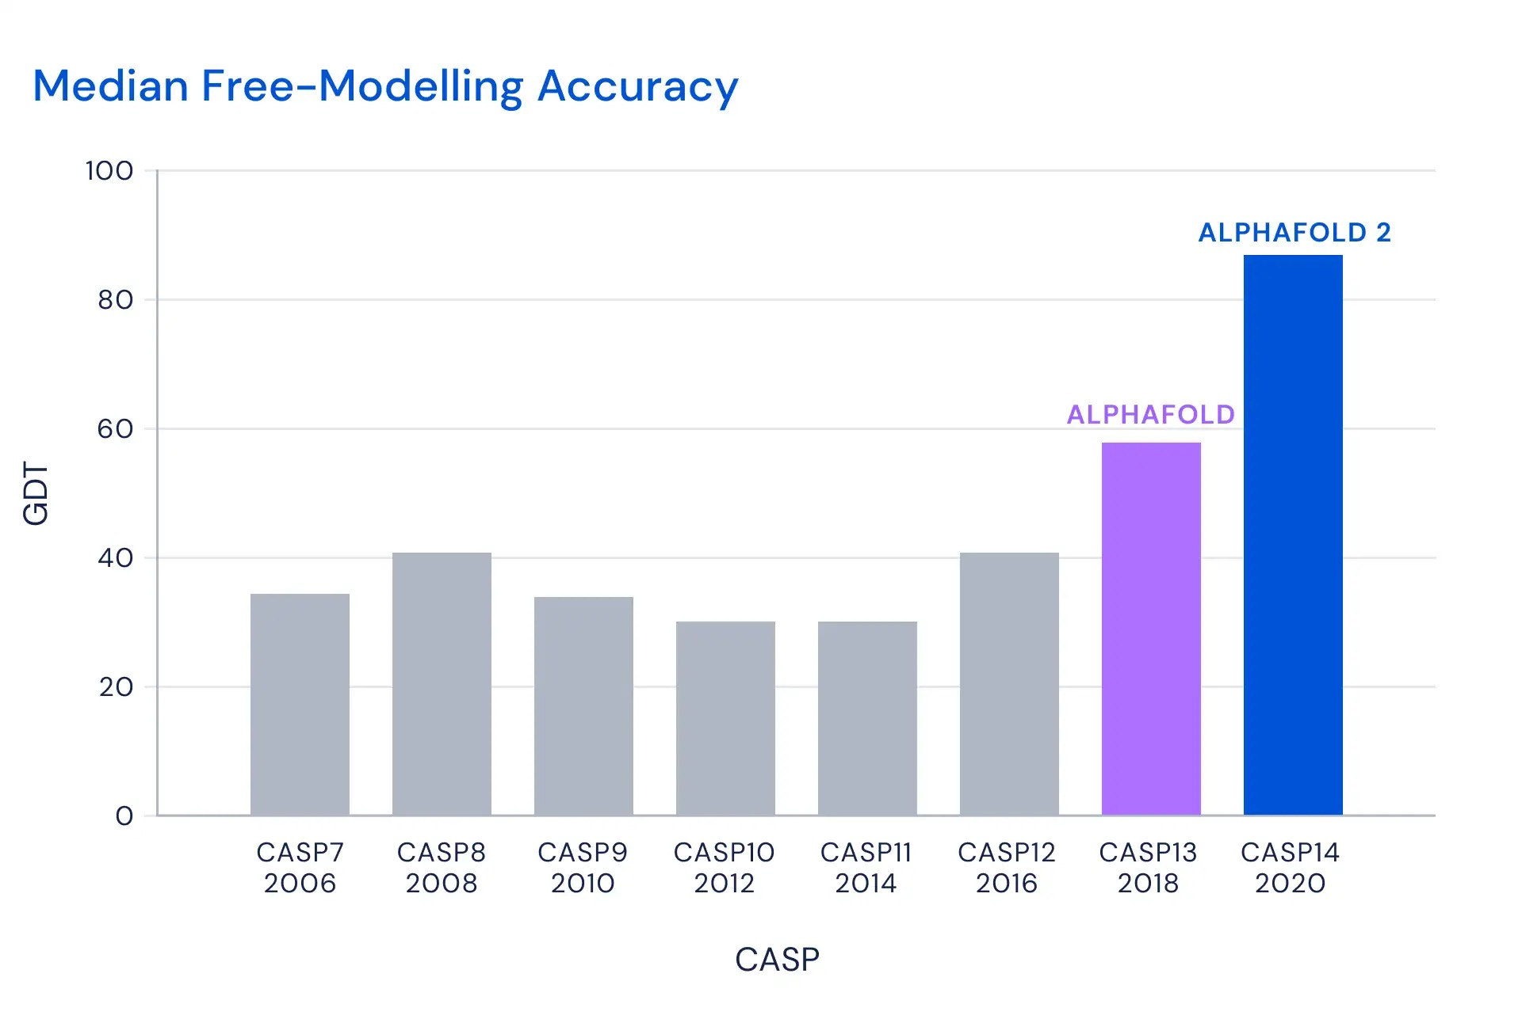
Critical Assessment of Structure Prediction
CASP provides research groups with an opportunity to objectively test their structure prediction methods.
Neither the predictors nor the organizers and assessors know the structures of the target proteins at the time when predictions are made.
Notes:
How do you know if your model is just memorizing the training dataset instead of learning?
Learning algorithms

Slide 7

AlphaFold 2
How does it work?

Slide 8
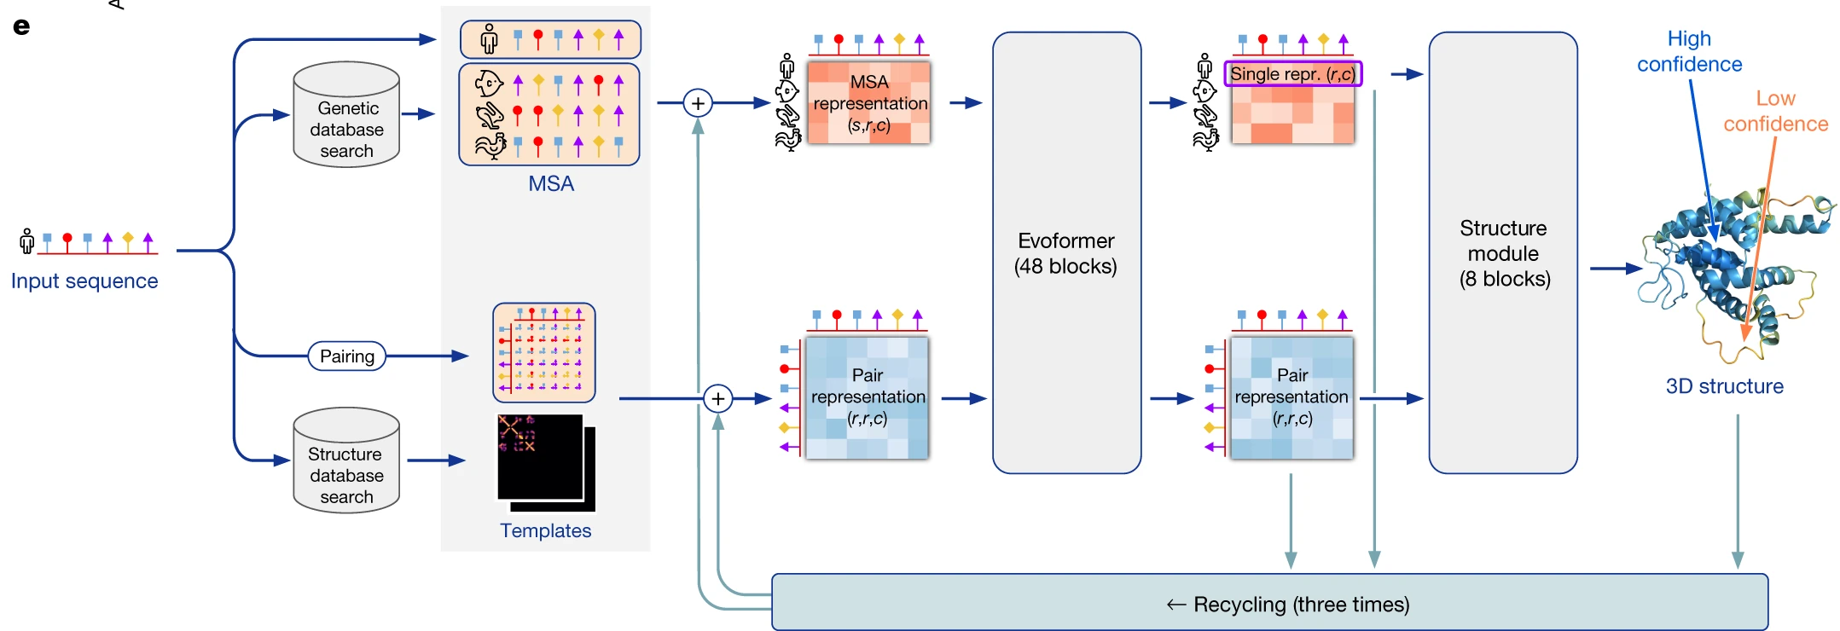
AlphaFold 2 Network Topology

Slide 9
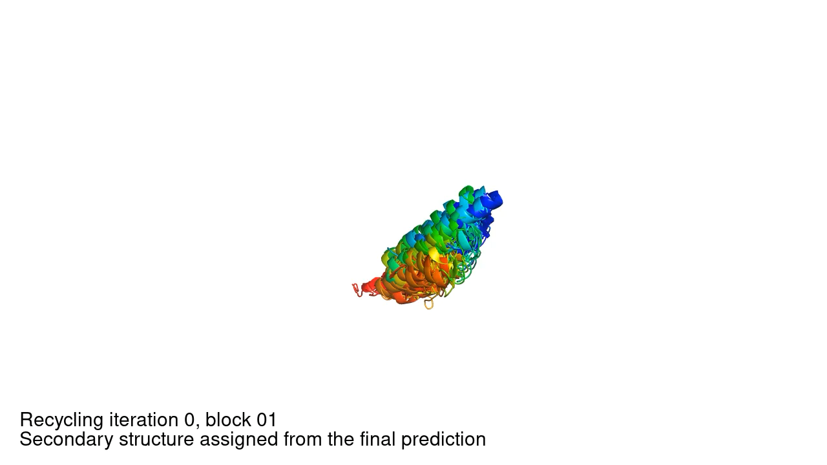
Intermediate structure trajectory : RNA polymerase of crAss-like phage

Slide 10
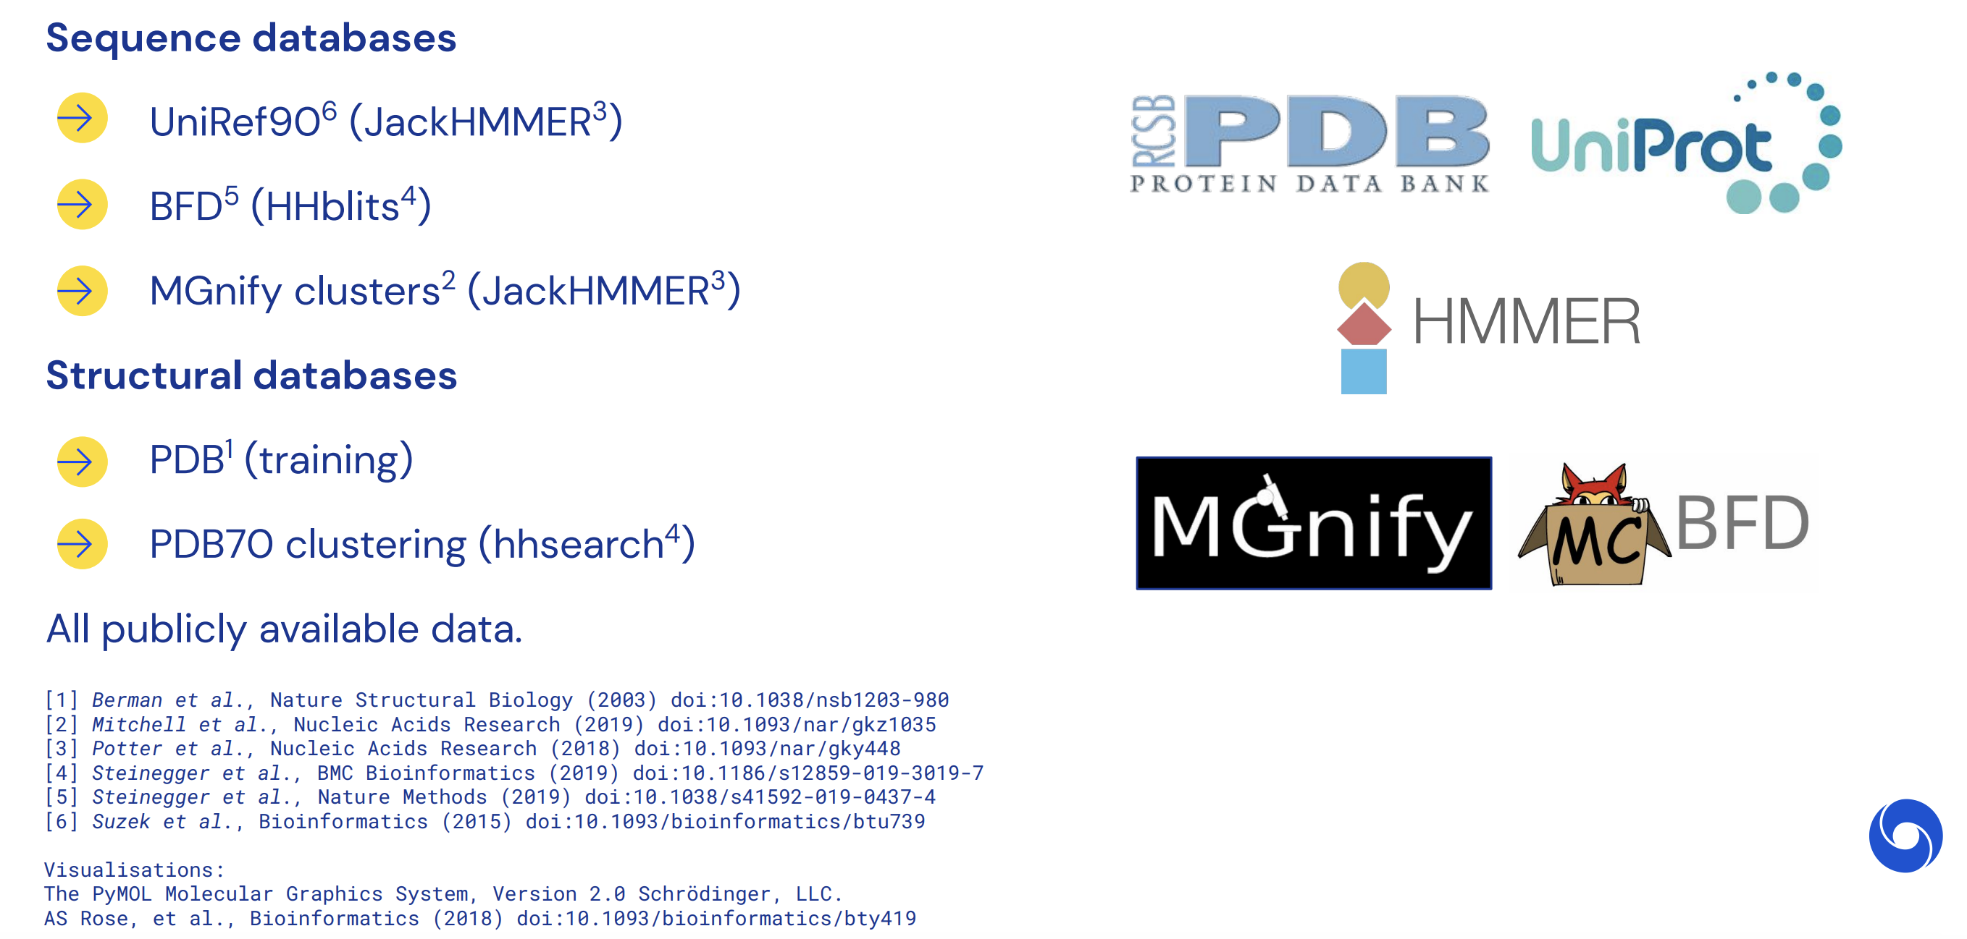

Inputs

Slide 11

Law of the instrument

Slide 12
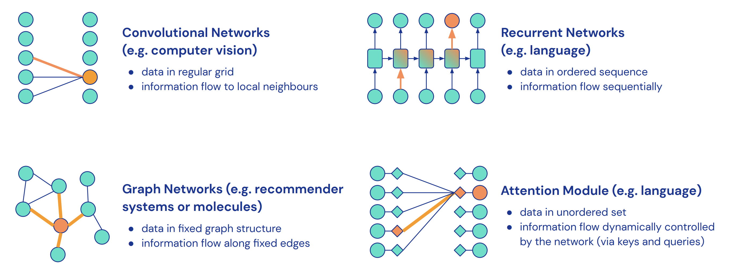
Law of the instrument

Slide 13
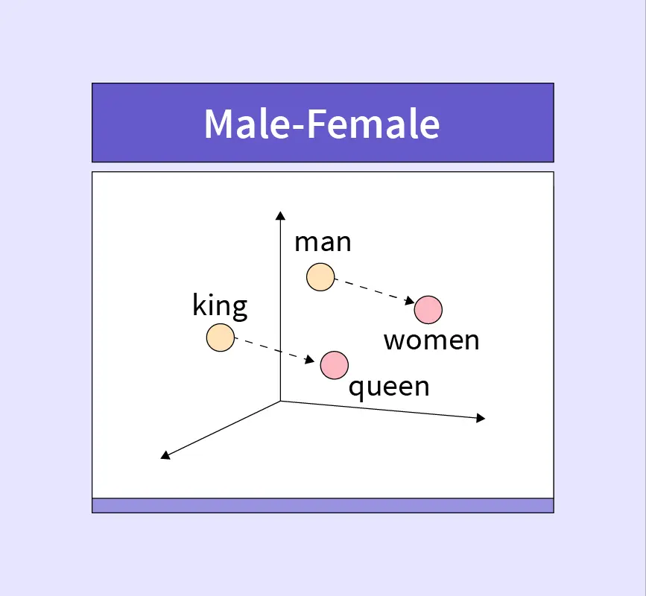
Embedding

Slide 14
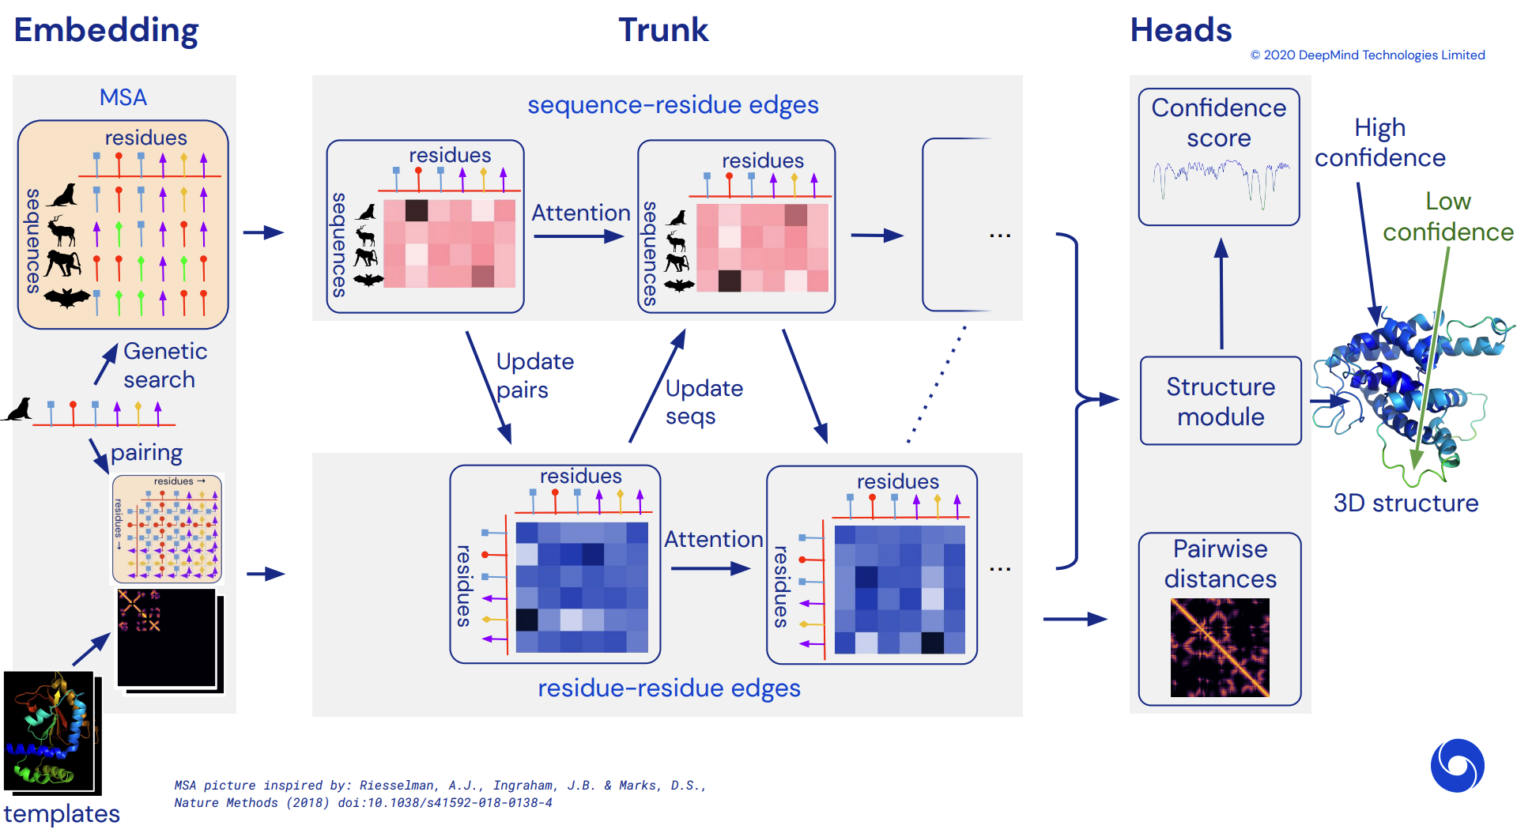

Evoformer

Slide 15
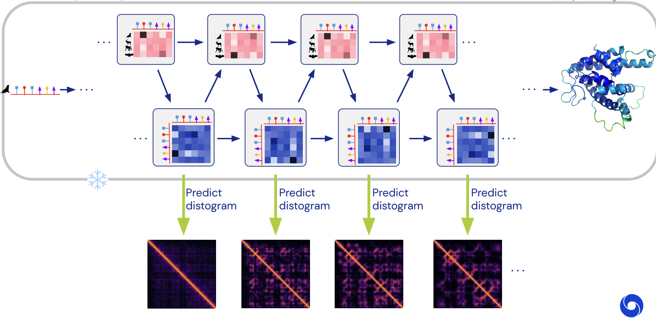

Interrogating the network

Slide 16
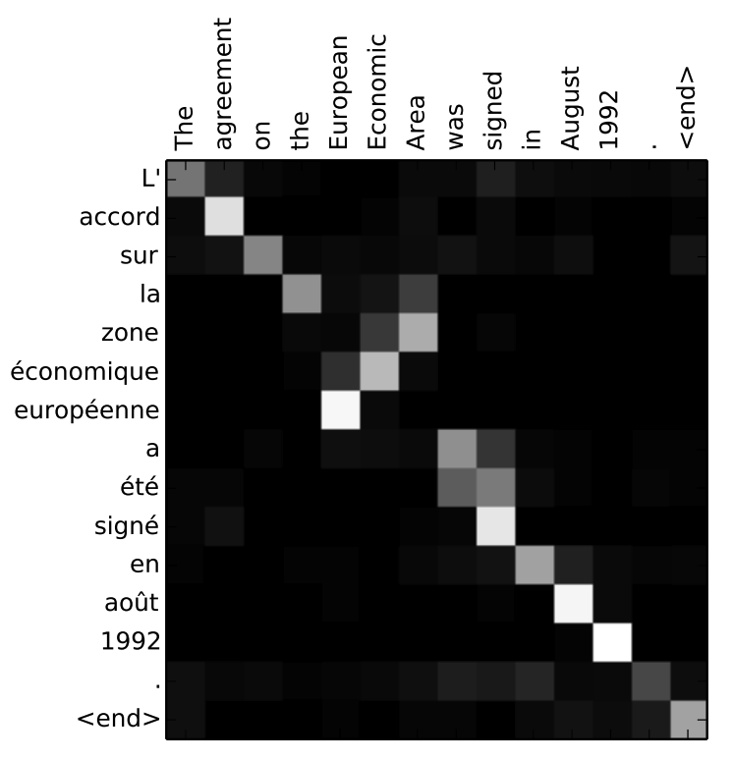
Transformers: Attention is all you need

Slide 17
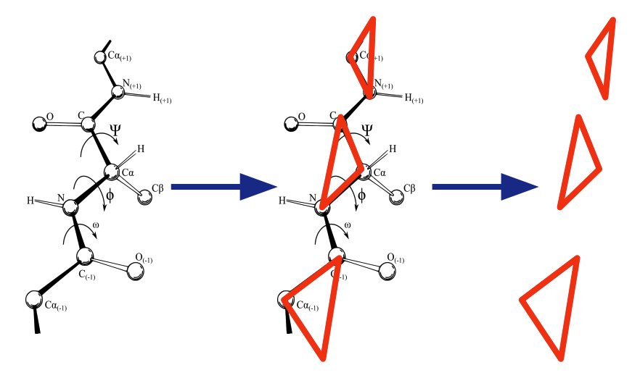
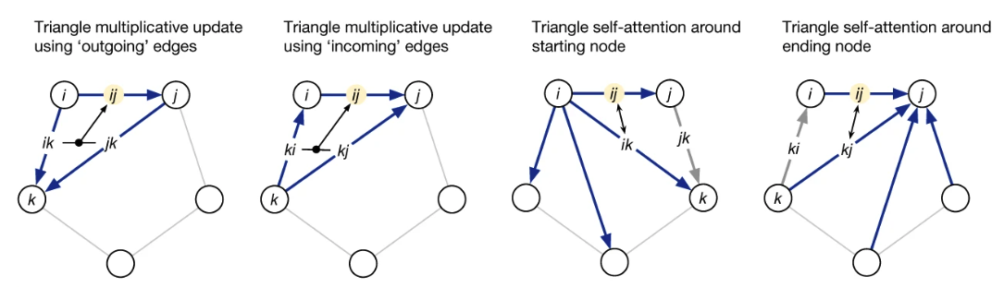
Structure module

Slide 18
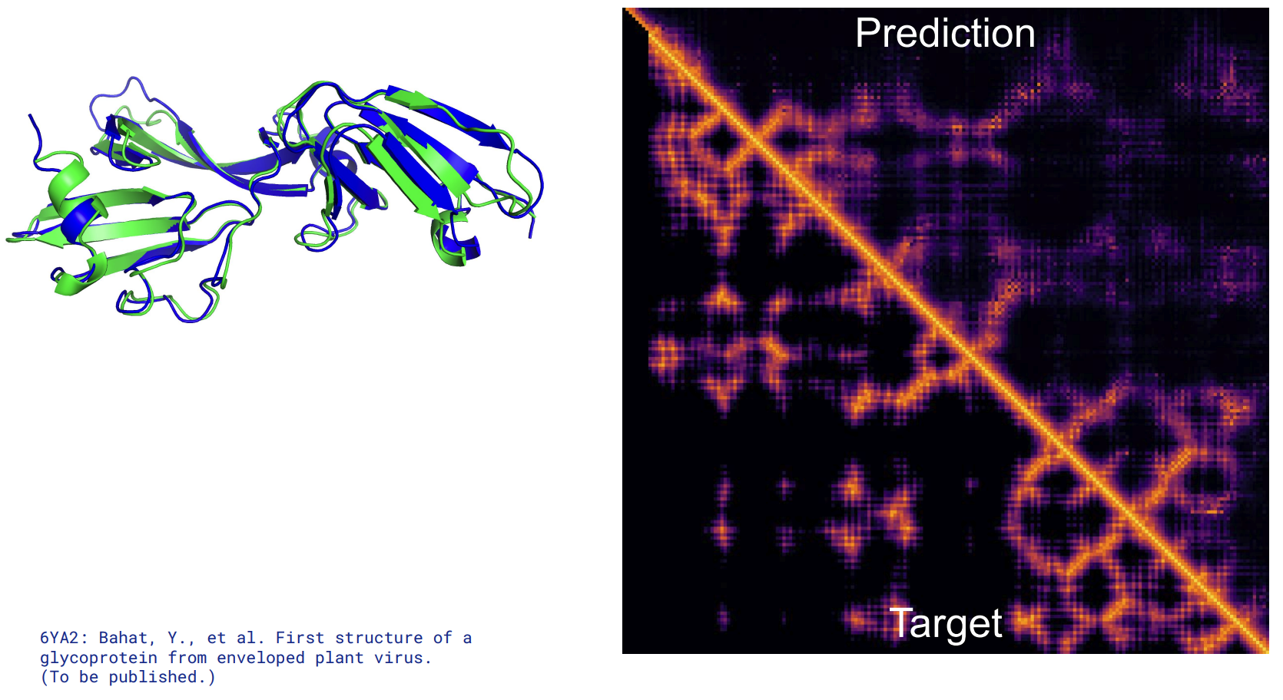


Slide 19
Metrics
Frame Aligned Point Error
It is not invariant to reflection and thus prevents creating proteins of the wrong chirality.
Distogram loss
MSA masking
Some symbols in MSA are masked out and the model is asked to predict them.
Similar to root-mean-squared deviation
Compare distogram prediction with ground truth

Slide 20
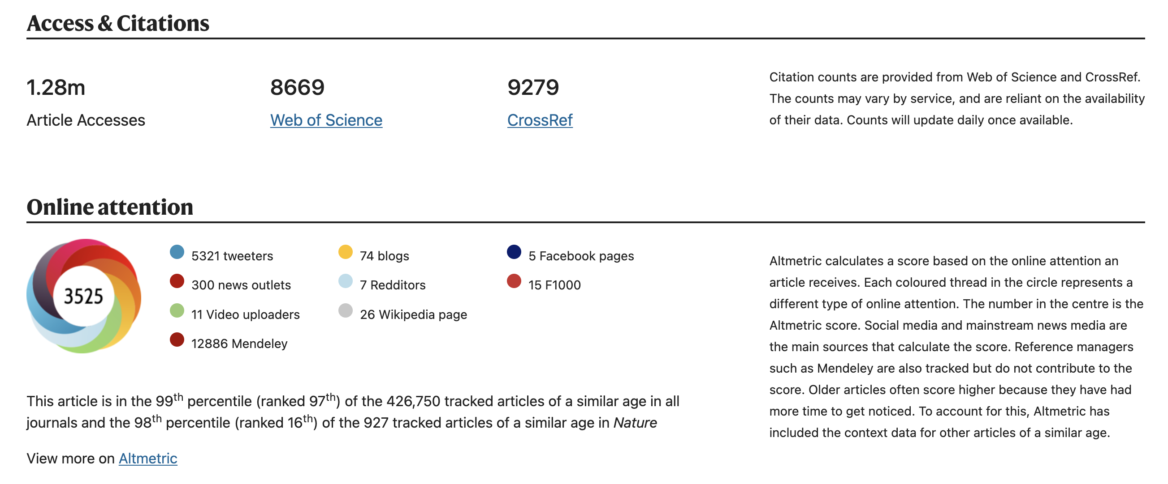
Impact

Slide 21
Impact
The DeepMind team published their method and made it freely available.
There is an online (free) tool called ColabFold where you can make predictions by making use of Google Computers.
CASP 15 (2022) was plenty of AlphaFold similar structures but DeepMind did not participate.

Slide 22
Conclusions
High-accuracy.
It became a popular tool in biology.
It may be over-engineered, meaning a simplified version achieved similar results.
Open the doors to other problems such as the reverse problem: given a known structure which are the possible sequences that could generate it.

Slide 23
Thank you!
Francisco J. Palmero Moya

